Slide 1
Are You Thirsty?
Robert Beasley

Slide 3
“I now believe that the universe was brought into existence by an infinite Intelligence. I believe that this universe’s intricate laws manifest what scientists have called the Mind of God.”
—Anthony Flew

Slide 4
John 1:14
“The Word became flesh and made his dwelling among us. We have seen his glory, the glory of the one and only Son, who came from the Father, full of grace and truth.”

Slide 5
John 14:9
“Anyone who has seen Me has seen the Father.”

Slide 6
John 4:4
Now he had to go through Samaria.

Slide 7
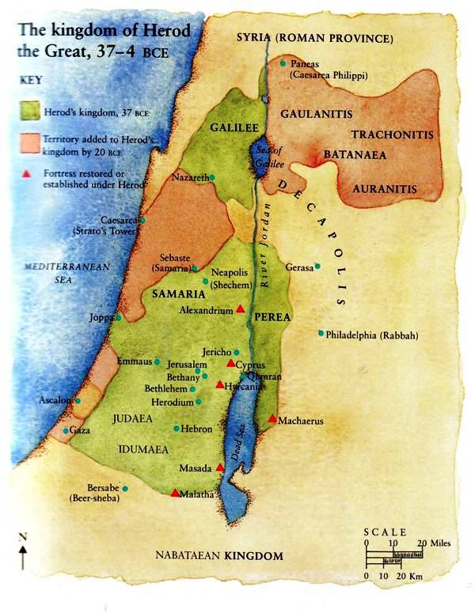

Slide 8
John 4:5-7
⁵ So he came to a town in Samaria called Sychar, near the plot of ground Jacob had given to his son Joseph. ⁶ Jacob’s well was there, and Jesus, tired as he was from the journey, sat down by the well. It was about noon.
⁷ When a Samaritan woman came to draw water, Jesus said to her, “Will you give me a drink?”

Slide 9
John 4:9-10
⁹ The Samaritan woman said to him, “You are a Jew and I am a Samaritan woman. How can you ask me for a drink?” (For Jews do not associate with Samaritans.)
¹⁰ Jesus answered her, “If you knew the gift of God and who it is that asks you for a drink, you would have asked him and he would have given

Slide 10
John 4:11&13-14
you living water.”
¹¹ “Sir,” the woman said, “you have nothing to draw with and the well is deep. Where can you get this living water?”
¹³ Jesus answered, “Everyone who drinks this water will be thirsty again, ¹⁴ but whoever drinks

Slide 11
John 4:14-15
the water I give them will never thirst. Indeed, the water I give them will become in them a spring of water welling up to eternal life.”
¹⁵ The woman said to him, “Sir, give me this water so that I won’t get thirsty and have to keep coming here to draw water.”

Slide 12
John 4:16-18
¹⁶ He told her, “Go, call your husband and come back.”
¹⁷ “I have no husband,” she replied.
Jesus said to her, “You are right when you say you have no husband. ¹⁸ The fact is, you have had five husbands, and the man you now have is not your husband. What you have just said is

Slide 13
John 4:19-21
quite true.”
¹⁹ “Sir,” the woman said, “I can see that you are a prophet. ²⁰ Our ancestors worshiped on this mountain, but you Jews claim that the place where we must worship is in Jerusalem.”
²¹“Woman,” Jesus replied, “believe me, a time is

Slide 14
John 4:21-23
coming when you will worship the Father neither on this mountain nor in Jerusalem.
²² You Samaritans worship what you do not know; we worship what we do know, for salvation is from the Jews.
²³ Yet a time is coming and has now come when

Slide 15
John 4:23-25
the true worshipers will worship the Father in spirit and in truth, for they are the kind of worshipers the Father seeks. ²⁴ God is spirit, and his worshipers must worship in spirit and in truth.”
²⁵ The woman said, “I know that Messiah” (called Christ) is coming. When he

Slide 16
John 4:25-26 & 28-29
comes, he will explain everything to us.”
²⁶ Then Jesus declared, “I, the one speaking to you—I am he.”
²⁸ Then, leaving her water bucket, the woman went back to the town and said to the people, ²⁹ “Come, see a man who told me everything I ever did. Could this be the Messiah?”

Slide 17
1. God is Intensely Personal.

Slide 18
Romans 8:15,16
“Now we call him, ‘Abba, Father.’ ¹⁶ For his Spirit joins with our spirit to affirm that we are God’s children.

Slide 19
2. God is the One doing the seeking.

Slide 20
Ecclesiastes 3:10-11
“He has made everything beautiful in its time. But he has also set eternity in the human heart.”

Slide 21
3. God can fill us only when we lose our bucket.
“leaving her water bucket…”

Slide 22
4. God calls us to community.

Slide 23
John 4:39-42
³⁹ Many of the Samaritans from that town believed in him because of the woman’s testimony, “He told me everything I ever did.” ⁴⁰ So when the Samaritans came to him, they urged him to stay with them, and he stayed two days. ⁴¹ And because of his words many more became believers. ⁴² They said to the woman,

Slide 24
John 4:39-42
“We no longer believe just because of what you said; now we have heard for ourselves, and we know that this man really is the Savior of the world.”

Slide 26
“There is no other stream,” said the Lion.

Slide 27
“You would not have called to me unless I had been calling to you,” said the Lion.

