Slide 1
Career or Calling?
Ronnie Norman

Slide 2
Genesis 2:15
The Lord God took the man and put him in the Garden of Eden to work it and to take care of it.

Slide 3
Ecclesiastes 3:12-13
12 I know that there is nothing better for people than to be happy and to do good while they live. 13 That each of them may eat and drink, and find satisfaction in all their toil—this is the gift of God.

Slide 4
How Faith Informs Your Work
Your faith gives you a broad view of common grace -- how God cares for the world through the meaningful & varied work of men and women.

Slide 5
How Faith Informs Your Work
Your faith gives you a broad view of common grace -- how God cares for the world through the meaningful & varied work of men and women.
Your faith helps you see and harness your gifts from God.

Slide 6
www.liveyourcalling.com

Slide 7
Romans 12
Try to have a sane estimate of your capabilities by the light of the faith that God has given to you.

Slide 8
Ministry of preparation
Ministry of competence

Slide 9
How Faith Informs Your Work
Your faith protects you from unhealthy responses to success, failure and boredom.

Slide 10
Luke 12:15
“Watch out! Be on your guard against all kinds of greed; life does not consist in an abundance of possessions.”

Slide 11
Colossians 3:23-24
23 Whatever you do, work at it with all your heart, as working for the Lord, not for human masters, 24 since you know that you will receive an inheritance from the Lord as a reward. It is the Lord Christ you are serving.

Slide 12
How Faith Informs Your Work
Your faith protects you from unhealthy responses to success, failure and boredom.
Your faith gives you a moral compass and ethical guidance.

Slide 13
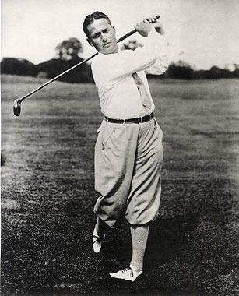

Slide 14
Micah 6:8
God has shown you what is good. And what does the Lord require of you? To act justly, to love mercy and to walk humbly with your God.

Slide 15
Matthew 7:12
So in everything, do to others what you would have them do to you, for this sums up the Law and the Prophets.

Slide 16
“Four Way Test”
Is it the truth?
Is it fair for all concerned?
Will it build goodwill and better friendships? and
Will it be beneficial to all concerned?”

