Slide 1
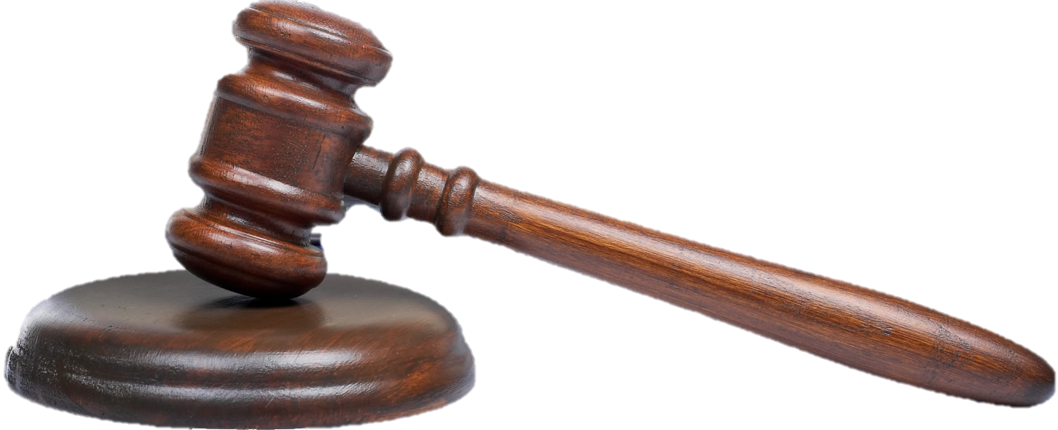
CHRISTIANITY ON TRIAL
A careful examination of the evidence

Slide 2
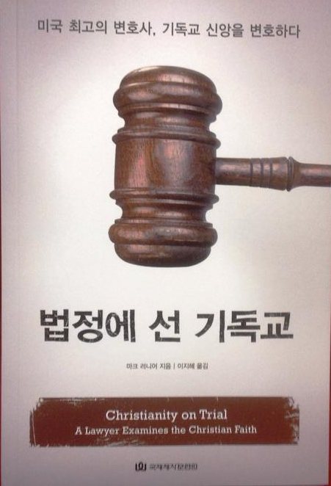

Slide 3
The key:
The Burden of Proof
51%
49%
What is more reasonable than not?

Slide 4
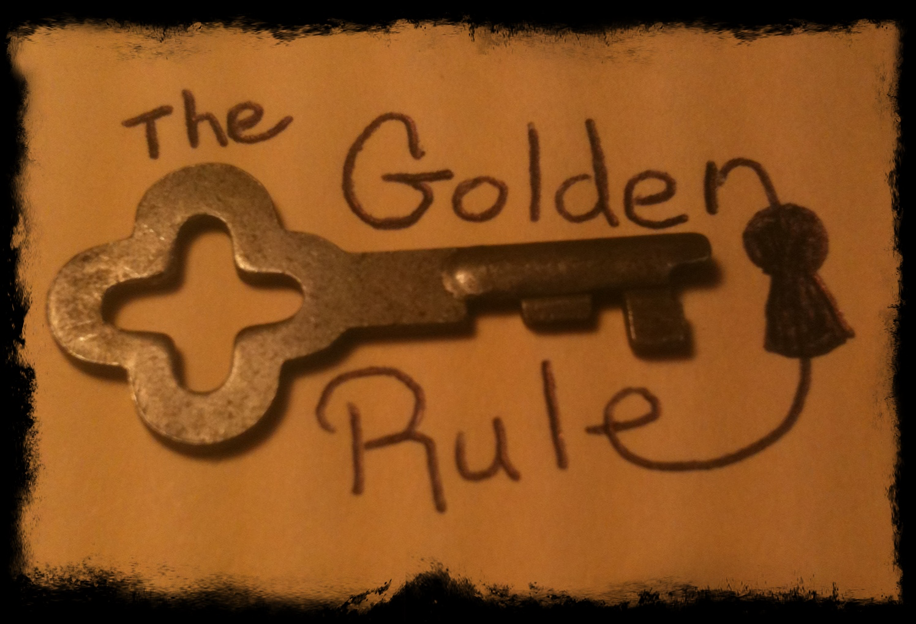
God? gods? Or nothing?
The role of circumstantial evidence

Slide 5
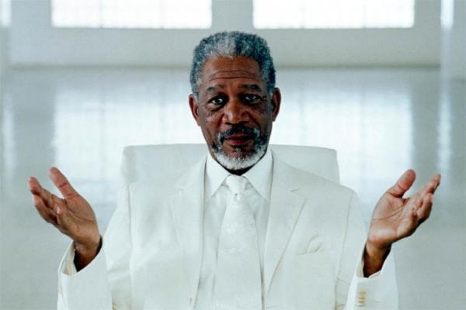
Who God is NOT
Morality cop?
Supersized Father?
Old man in the sky?
The Force?
The God of many paths?

Slide 6
Who God is NOT
God of strict perfection
The Escape God?
Good fortune?
God of our group?
Removed supervisor?

Slide 7
Who God is NOT
Secondhand God?
Personal Grievance?
Boring killjoy?
Fun-house mirror?
God for the elite?

Slide 8
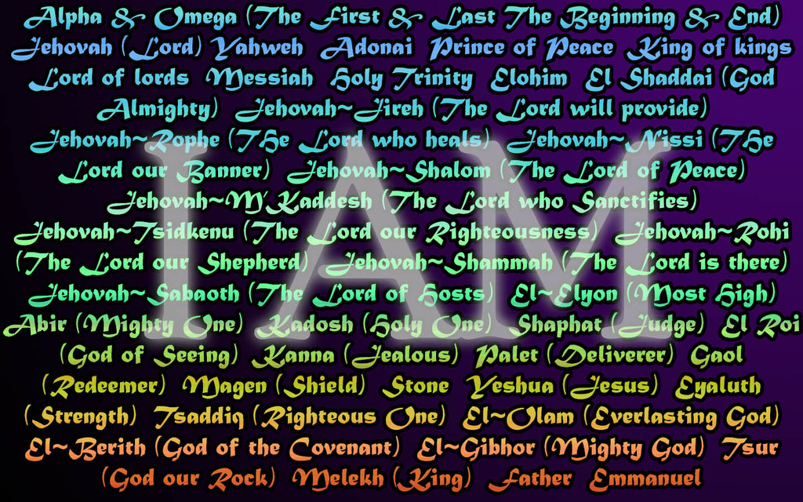
Who is God?

Slide 9
Bio-linguistics and the Communicating God

Slide 10
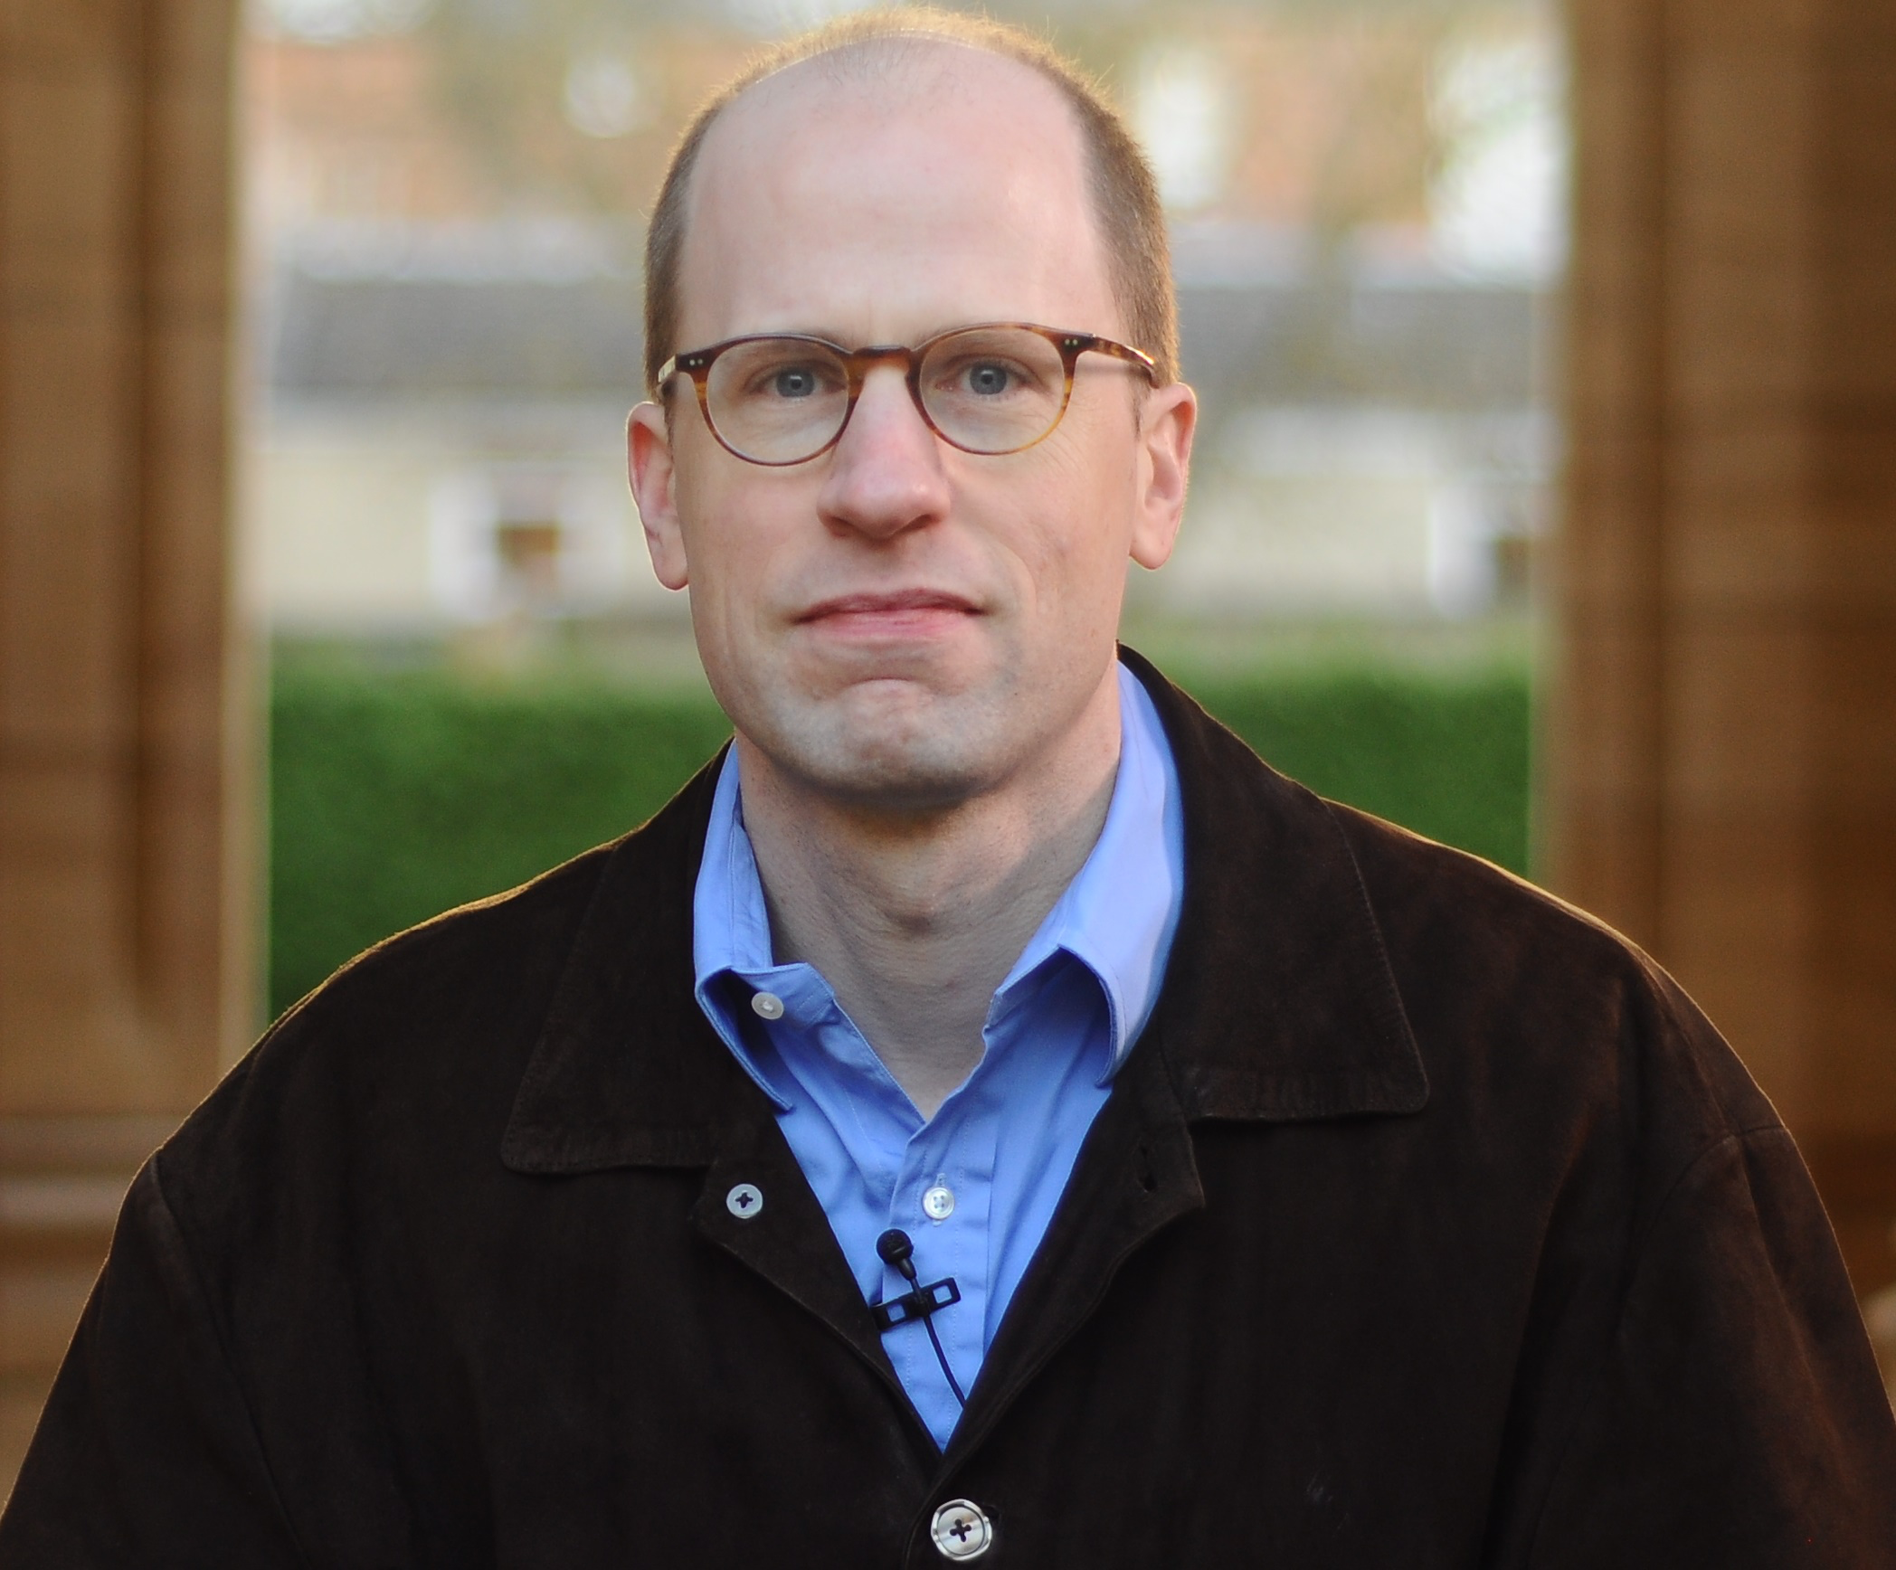
Reality and
the Truth of God
Nick Bostrum

Slide 11
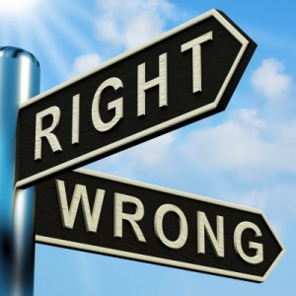
Right, Wrong, and the moral God

Slide 12
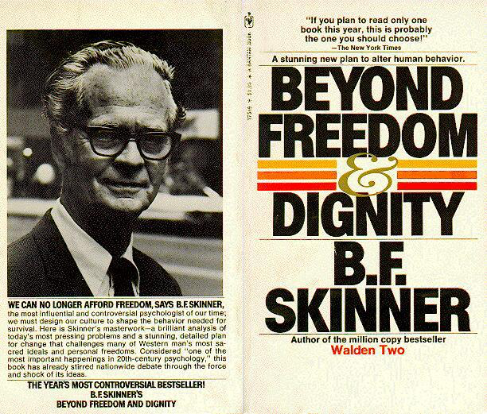
Free Will and Moral Responsibility

Slide 13
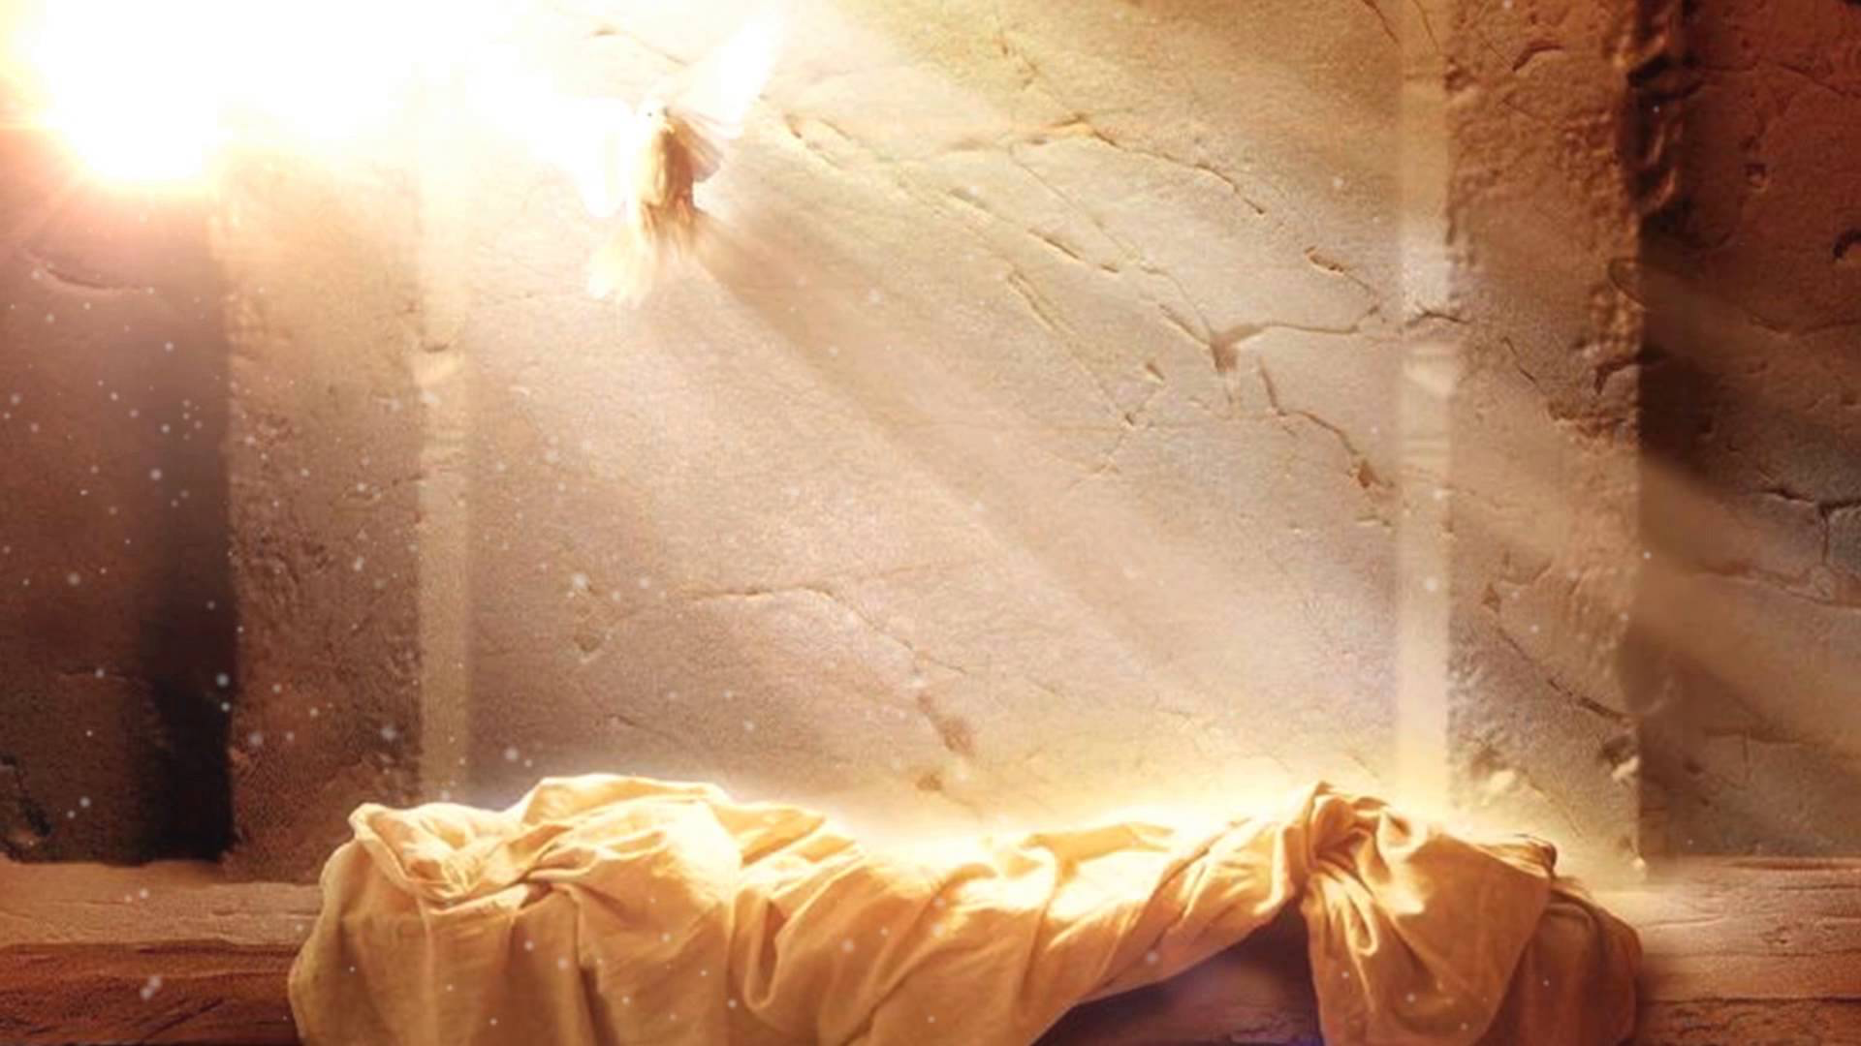
The Audacity of the Resurrection

Slide 14
CHRISTIANITY ON TRIAL
A careful examination of the evidence

