Slide 1
Don’t Forget To Remember
Ronnie Norman

Slide 2
Matthew 26:26-29
26 While they were eating, Jesus took bread, and when he had given thanks, he broke it and gave it to his disciples, saying, “Take and eat; this is my body.”
27 Then he took a cup, and when he had given thanks, he gave it to them, saying, “Drink from it, all of you. 28 my blood of the covenant, which

Slide 3
Matthew 26:26-29
is poured out for many for the forgiveness of sins. 29 I tell you, I will not drink from this fruit of the vine from now on until that day when I drink it new with you in my Father’s kingdom.”

Slide 4
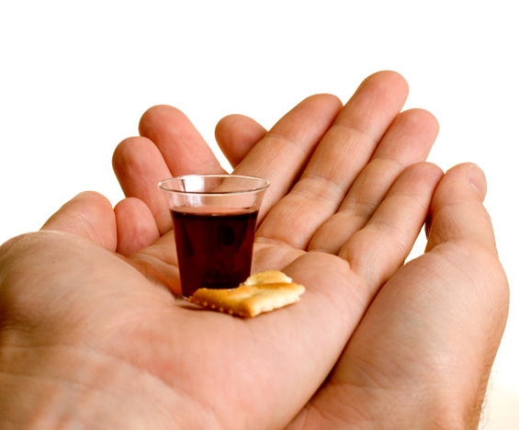
“…do this in remembrance of me.”

Slide 5
I have a Father who will not let me go.

Slide 6
Romans 8:38-39
For I am convinced that neither death nor life, neither angels nor demons, neither the present nor the future, nor any powers, 39 neither height nor depth, nor anything else in all creation, will be able to separate us from the love of God that is in Christ Jesus our Lord.

Slide 7
I have a Father who will not let me go.
I have a faith family to share my journey.

Slide 8
John 13:34
A new command I give you: Love one another. As I have loved you, so you must love one another.

Slide 9
I have a Father who will not let me go.
I have a faith family to share my journey.
I have a focus that gives great purpose
to my life.

Slide 10
“I am a lifelong, enthusiastic follower of
Jesus Christ”

Slide 11
Matthew 28:19-20
19 Therefore go and make disciples of all nations, baptizing them in the name of the Father and of the Son and of the Holy Spirit, 20 and teaching them to obey everything I have commanded you.

Slide 12
I have a Father who will not let me go.
I have a faith family to share my journey.
I have a focus that gives great purpose
to my life.
I have forgiveness that is full and free.

Slide 13
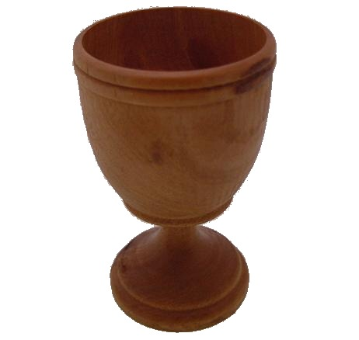
“This is my blood of the covenant, which is poured out for many for the forgiveness of sins.”

Slide 14
I have a Father who will not let me go.
I have a faith family to share my journey.
I have a focus that gives great purpose
to my life.
I have forgiveness that is full and free.
I have a future that is out of this world.

Slide 15
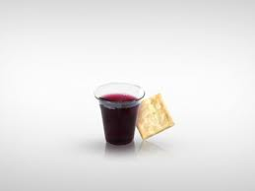
1 Corinthians 11:26
For whenever you eat this bread and drink this cup, you proclaim the Lord’s death until he comes.

Slide 17
Father
Faith family
Focus
Forgiveness
Future

