Slide 1
Grace Community
Jim Howard
Amazing
Grace

Slide 2
John 17:20b-23
“I pray for those who will believe in me through their (the disciples) message, that all of them may be one, Father, just as you are in me and I am in you and I am in you. May they also be in us so that the world may believe that you
have sent me. I have given them

Slide 3
John 17:20b-23
the glory that you gave me, that they may be one as we are one. I in them and you in me. May they be brought to complete unity to let the world know that you sent me and have loved them even as you have loved me.

Slide 4
A community of grace happens when you see yourself correctly.
Amazing
Grace

Slide 5
Luke 13:1-7
Now there were some present at that time who told Jesus about the Galileans whose blood Pilate had mixed with their sacrifices. 2 Jesus answered, , “Do you think that these Galileans were worse sinners than all the other Galileans because they suffered this way?

Slide 6
Luke 13:1-7
3 I tell you, no! But unless you repent, you too will all perish. 4 Or those eighteen who died when the tower in Siloam fell on them—do you think they were more guilty than all the others living in Jerusalem? 5 I tell you, no! But unless you repent, you too will perish.”

Slide 7
Luke 13:1-7
6 Then he told this parable: “A man had a fig tree growing in his vineyard, and he went to look for fruit on it but did not find any. 7 So he said to the man who took care of the vineyard, ‘For three years now I’ve been coming to look for fruit on this fig tree and haven’t found

Slide 8
Luke 13:1-7
any. Cut it down! Why should it use up the soil?’
Amazing
Grace

Slide 9
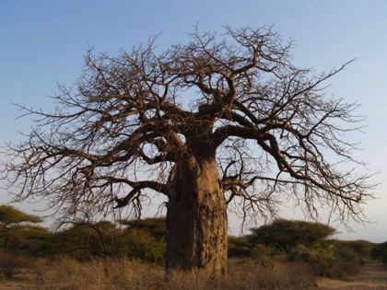

Slide 10
John 1:17
For the law was given through Moses; grace and truth came through Jesus Christ.
Amazing
Grace

Slide 11
Romans 6:18
Slave to sin vs. Slave to righteousness…
Amazing
Grace

Slide 12
Romans 4:5 (LB)
But people cannot do any work that will make them right with God. So they must trust Him, who makes even evil people right is His sight. Then God accepts their faith, and that makes them right with Him.

Slide 13
Dying to self brings community to life!
Amazing
Grace

Slide 14
A community of grace happens when grace comes first.
Amazing
Grace

Slide 15
Luke 23:34
“Forgive them Father, for they do not know what they do….”
Amazing
Grace

Slide 16
Andy Stanley
"Transparency and honesty are dangerous in a church created for church people. Consequently, the casualty in a church for church people is grace. It’s hard to extend grace to people who don’t seem to need it. And it’s hard to admit you need it when you aren’t sure you will receive it."

Slide 17
Ephesians 2:12 (LB)
Remember that in those days you were living utterly apart from Christ…you were lost, without God, without Hope.
Amazing
Grace

