Slide 1
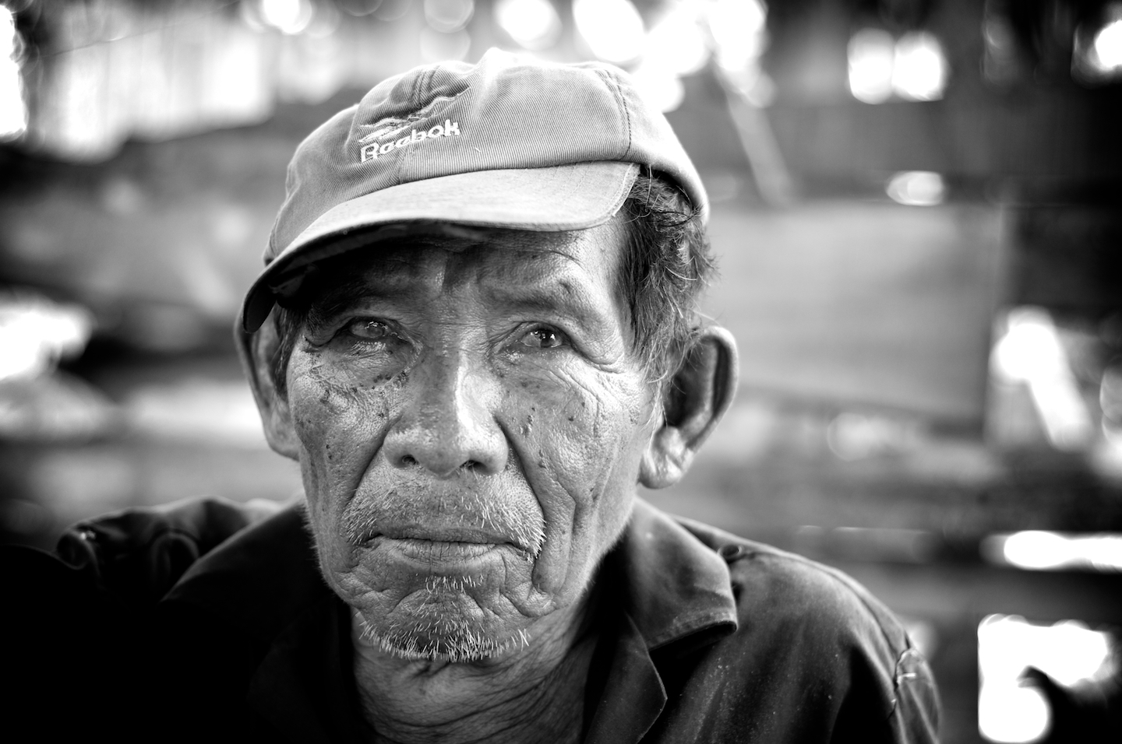
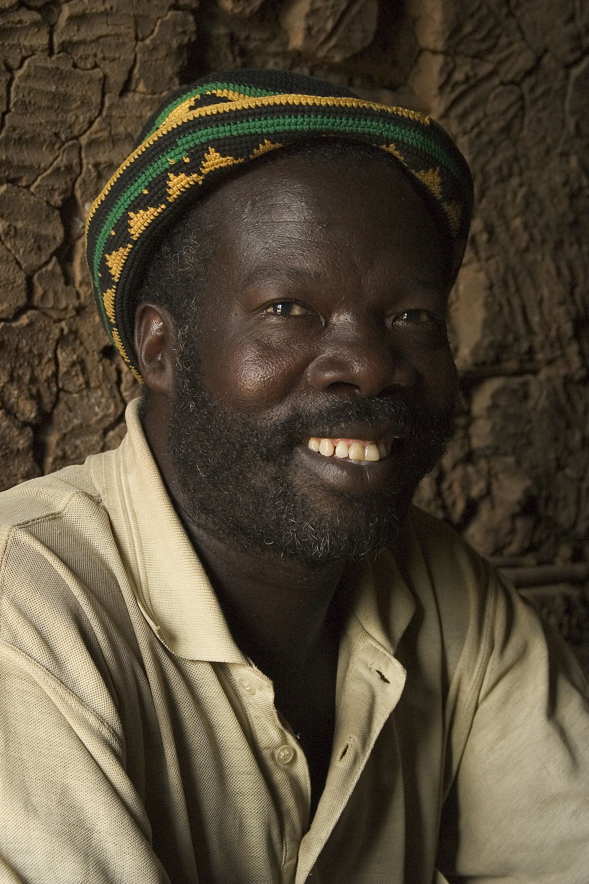
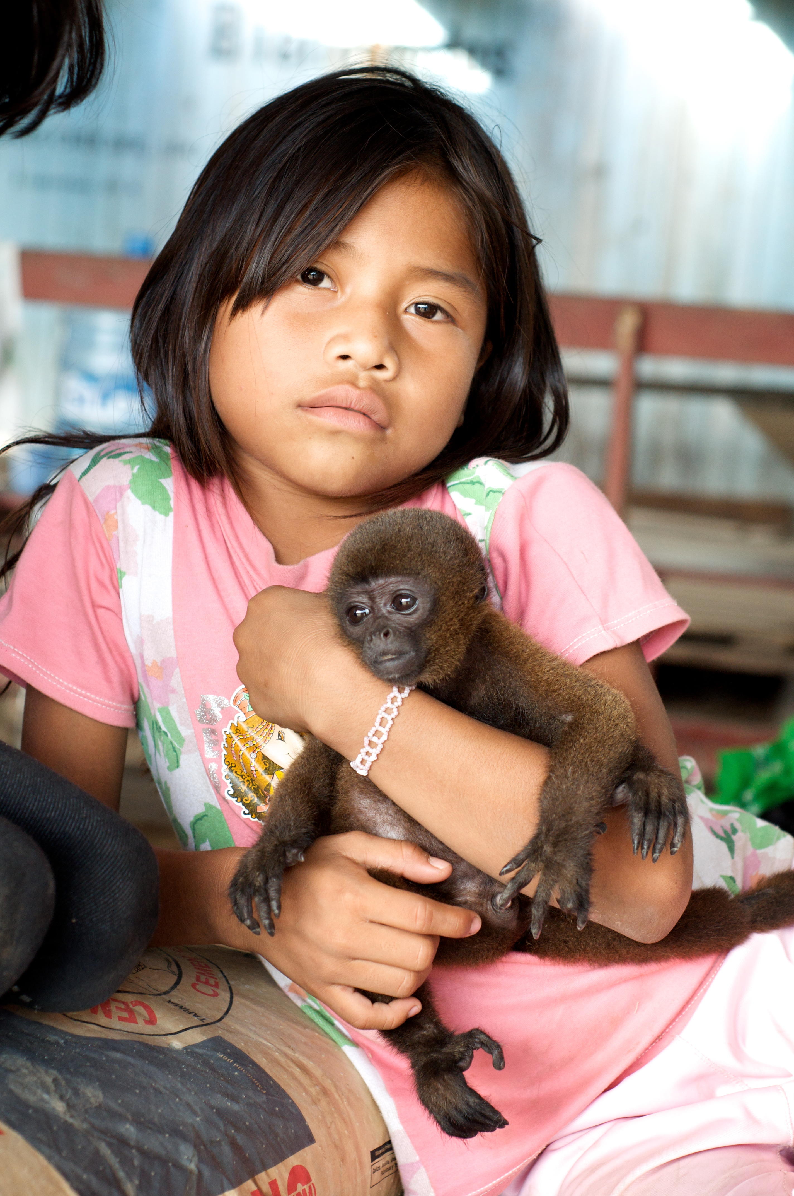
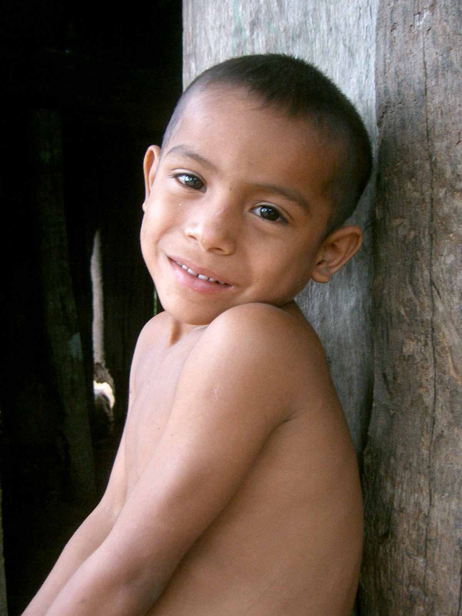
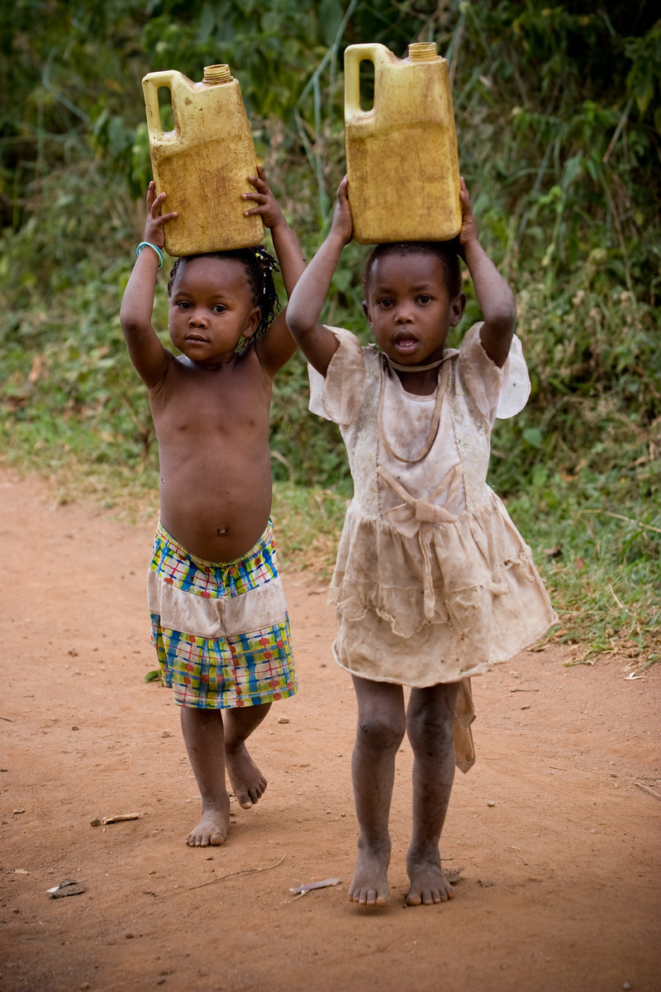
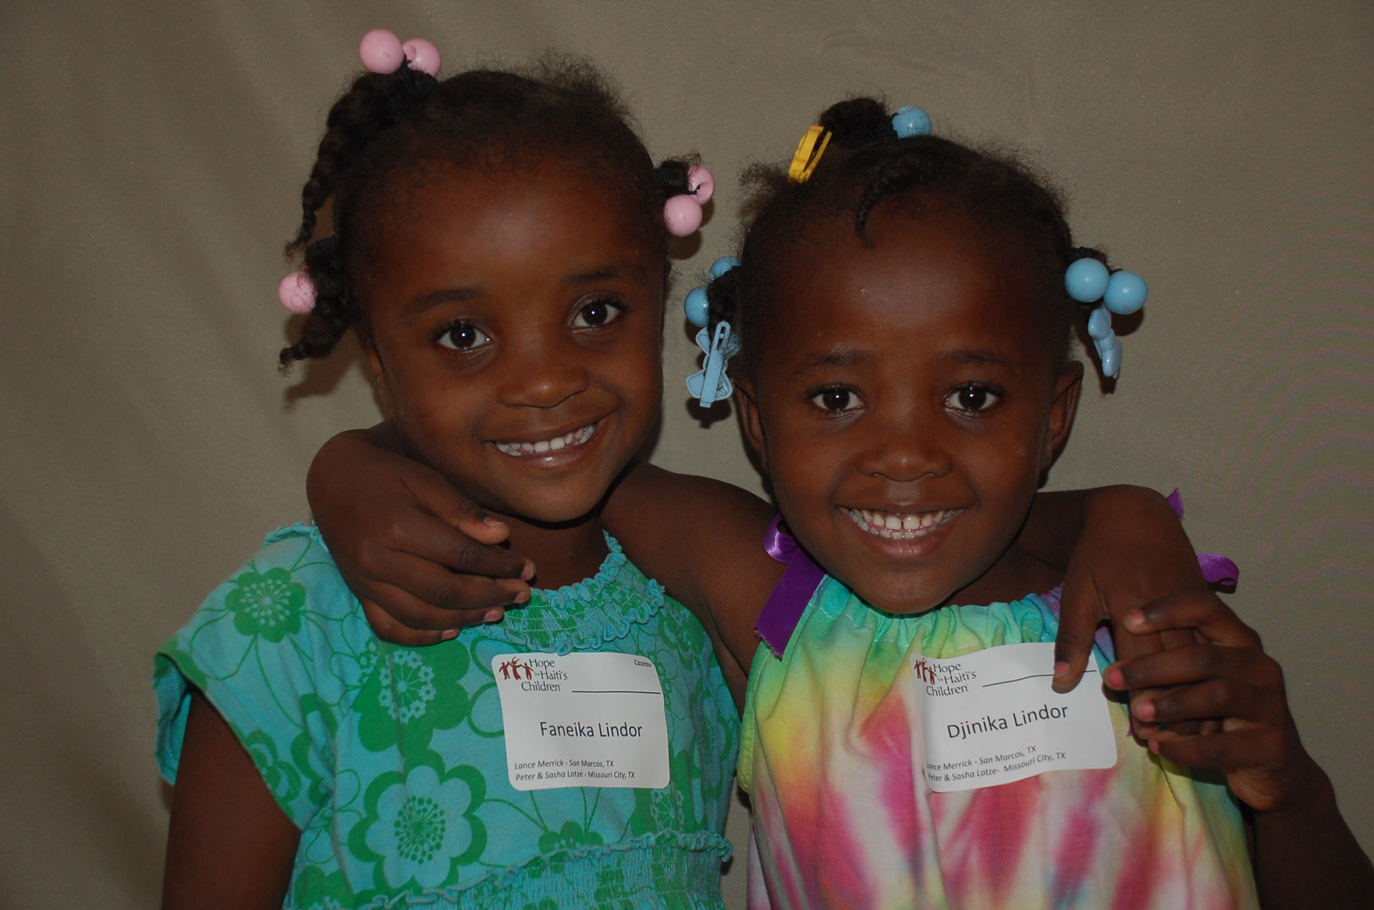
Missions Sunday 2012
Ronnie Norman

Slide 2
Matthew 28:19-20
¹⁹ Therefore go and make disciples of all nations, baptizing them in the name of the Father and of the Son and of the Holy Spirit, ²⁰ and teaching them to obey everything I have commanded you. And surely I am with you always, to the very end of the age.”

Slide 3
Our vision is to go global with disciple-making better than anybody else.

Slide 4
We send quality people into the mission field.

Slide 5
We send quality people into the mission field.
We offer the real thing – no imitations.

Slide 6
We send quality people into the mission field.
We offer the real thing – no imitations.
We do this “for the glory of God.”

Slide 7
We send quality people into the mission field.
We offer the real thing – no imitations.
We do this “for the glory of God.”
We pay attention to our mission work.

Slide 8
We send quality people into the mission field.
We offer the real thing – no imitations.
We do this “for the glory of God.”
We pay attention to our mission work.
Think missions and missional.

