Slide 1
THE CROSS!
Speaker: Robert Beasley

Slide 2
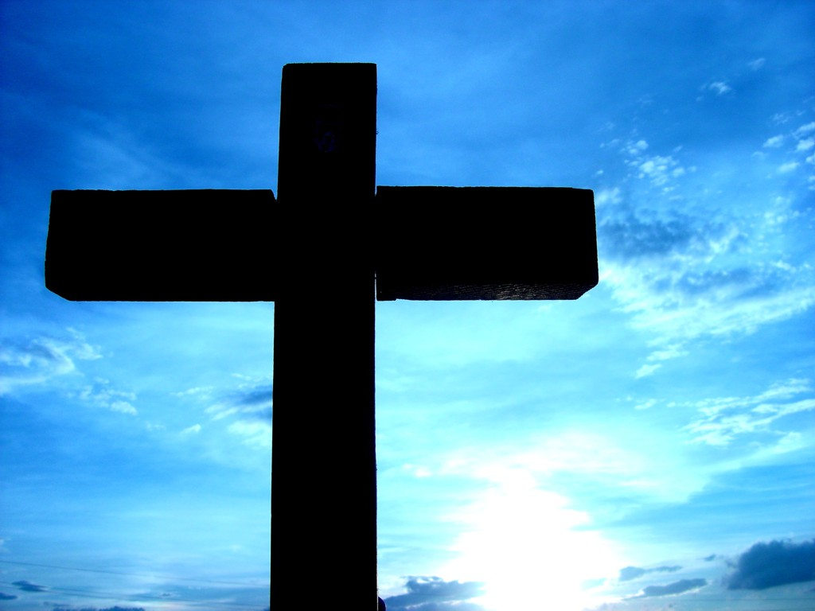

Slide 3
The Cross is shocking.

Slide 4
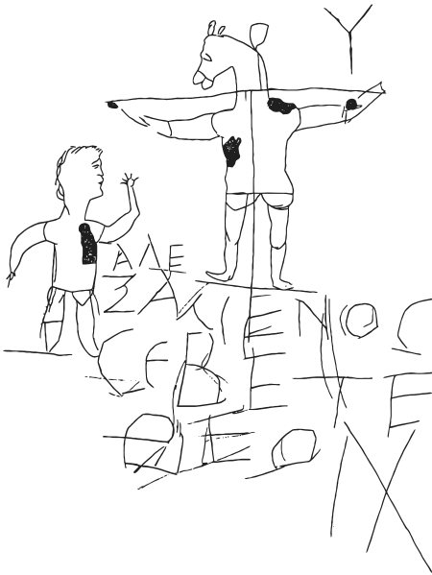

Slide 5
Deuteronomy 21:23
“Anyone who is hung on a tree is under God’s curse”

Slide 6
Mark 15:17-20
They put a purple robe on him, then twisted together a crown of thorns and set it on him. And they began to call out to him, “Hail, king of the Jews!” Again and again they struck him on the head with a staff and spit on him. Falling on their knees, they

Slide 7
Mark 15:17-20
paid homage to him. And when they had mocked him, they took off the purple robe and put his own clothes on him. Then they led him out to crucify him.

Slide 8
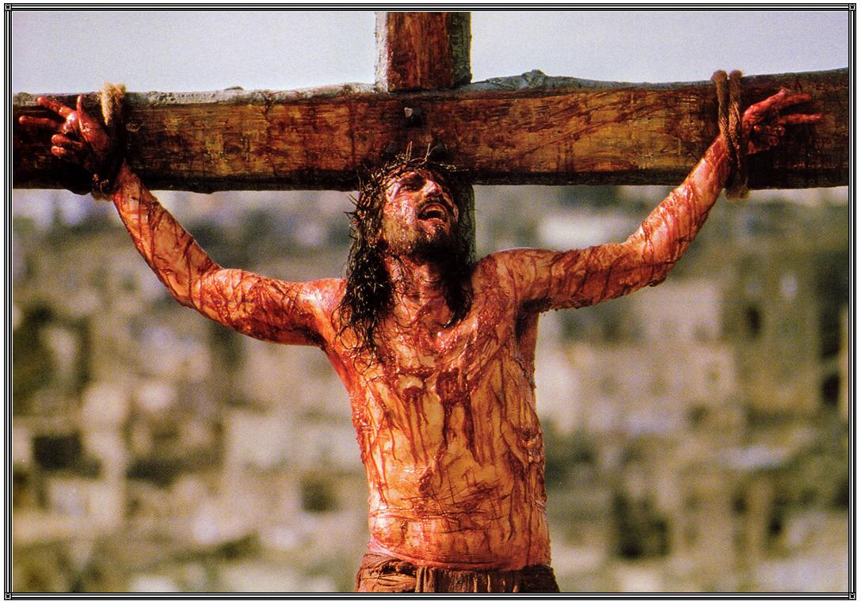

Slide 9
1 Corinthians 1:18
For the message of the cross is foolishness to those who are perishing, but to us who are being saved it is the power of God.

Slide 10
The Cross was Planned.

Slide 11
Luke 18: 31-33
“Jesus took the twelve aside and told them, ‘We are going up to Jerusalem, and everything that is written by the prophets about the Son of Man will be fulfilled. He will be handed over to the Gentiles. They will mock him, insult him, spit on him, flog

Slide 12
Luke 18: 31-33
him and kill him. On the third day he will rise again”

Slide 13
Isaiah 53:4-5
“Surely he took up our infirmities and carried out sorrows, yet we considered him stricken by God, smitten by him and afflicted. But he was pierced for our transgressions, he was crushed for our iniquities; the punishment that brought us

Slide 14
Isaiah 53:4-5
peace is upon him, and by his wounds we are healed.”

Slide 15
“For he chose us in him before the creation of the world to be holy and blameless in his sight” (Ephesians 1:4)
“He was chosen before the creation of the world but was revealed in these last times for your sake” (1 Peter 1:20)

Slide 16
The Cross reveals the Glory of God

Slide 17
John 12:23, 27, 28
“The hour has come for the Son of Man to be glorified…Now my heart is troubled, and what shall I say?’ Father, save me from this hour?’ No, it was for this very reason I came to this hour. Father, glorify your name!”

Slide 18
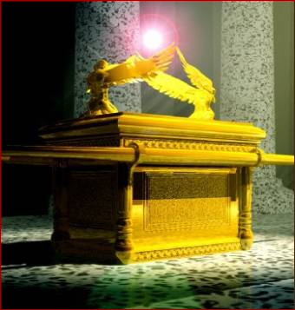

Slide 19
Leviticus 16:2
“…because I appear in the cloud over the atonement cover.”

Slide 20
Romans 3:25
God presented Christ as a sacrifice of atonement, through the shedding of his blood – to be received by faith.

Slide 21
Romans 3:25b-26
He did this to demonstrate his righteousness, because in his forbearance he had left the sins committed beforehand unpunished – ²⁶ he did it to demonstrate his righteousness at the present time, so as to be just and the one who justifies those who have faith in Jesus.

Slide 22
4. The Cross reveals the Heart of God

Slide 24
Philippians 2:6-11
“Who, being in very nature God, did not consider equality with God something to be used to his own advantage; rather, he made himself nothing by taking the very nature of a servant, being made in human likeness. And being found in appearance

Slide 25
Philippians 2:6-11
as a man, he humbled himself by becoming obedient to death—even death on a cross!
Therefore God exalted him to the highest place and gave him the name that is above every name, that at the name of Jesus every knee should bow, in heaven and

Slide 26
Philippians 2:6-11
on earth and under the earth, and every tongue acknowledge that Jesus Christ is Lord, to the glory of God the Father.”

Slide 27
John 6:12
“Gather up the leftover fragments, that nothing my be lost.”

Slide 28
Romans 8:31, 32, 37-39
“ What, then, shall we say in response to these things? If God is for us, who can be against us? He who did not spare his own Son, but gave him up for us all—how will he not also, along with him, graciously give us all things? Who will bring any charge

Slide 29
Romans 8:31, 32, 37-39
against those whom God has chosen? It is God who justifies. Who then is the one who condemns? No one. Christ Jesus who died—more than that, who was raised to life—is at the right hand of God and is also interceding for us.

Slide 30
Romans 8:31, 32, 37-39
I am convinced that neither death nor life, neither angels nor demons, neither the present nor the future, nor any powers, neither height nor depth, nor anything else in all creation, will be able to separate us from the love of God that is in Christ Jesus our Lord.”

