Slide 1
Those Crazy Co-Workers
Ronnie Norman

Slide 2
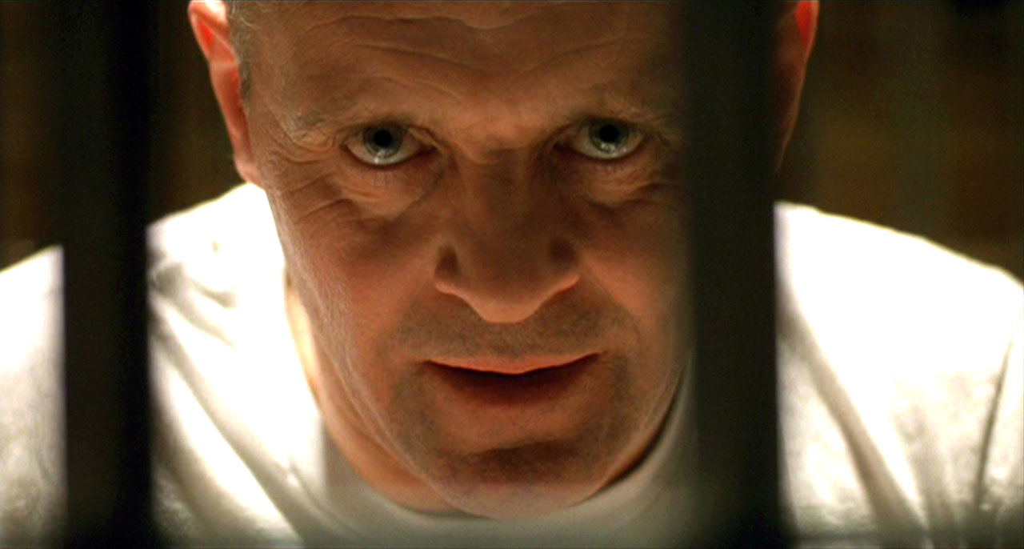

Slide 3
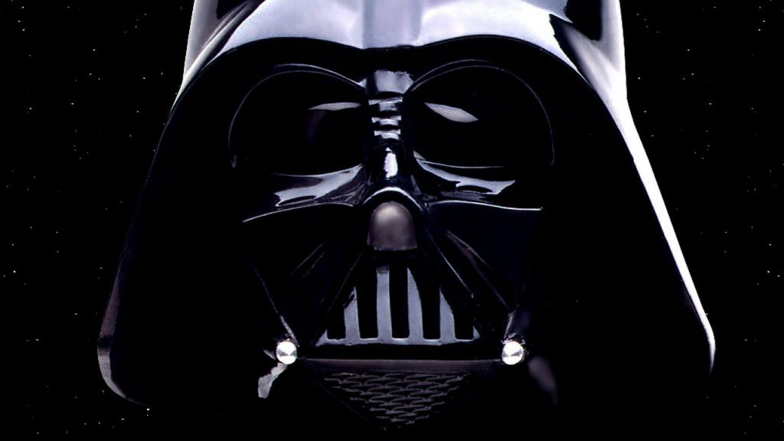

Slide 4
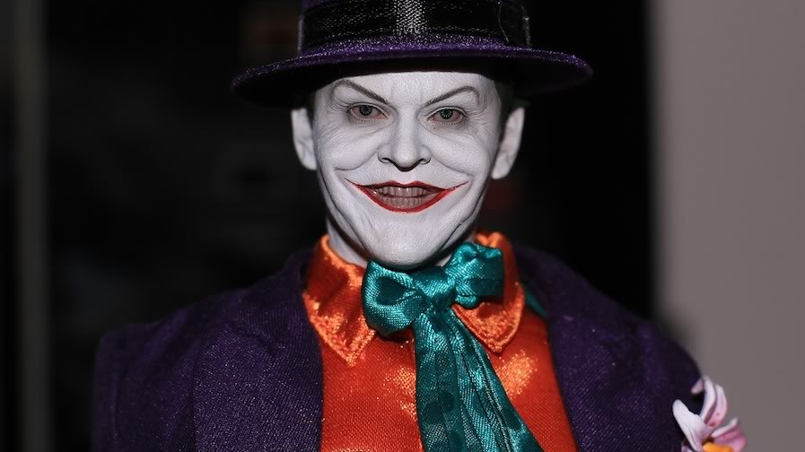

Slide 5
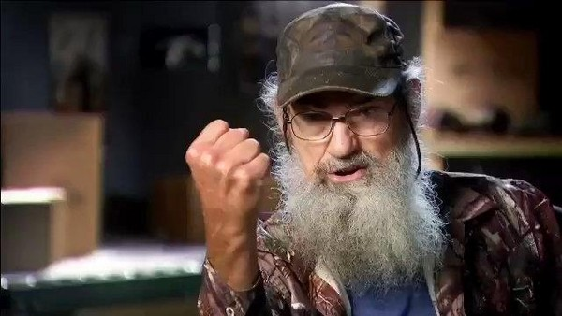

Slide 6
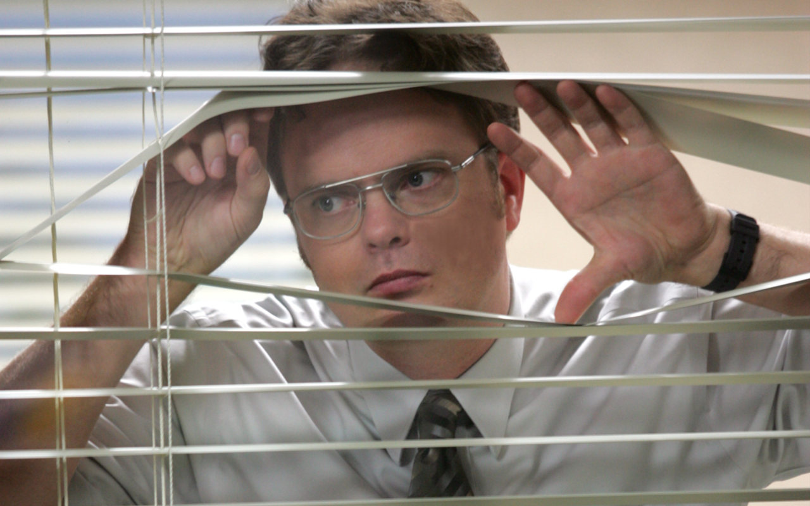

Slide 7
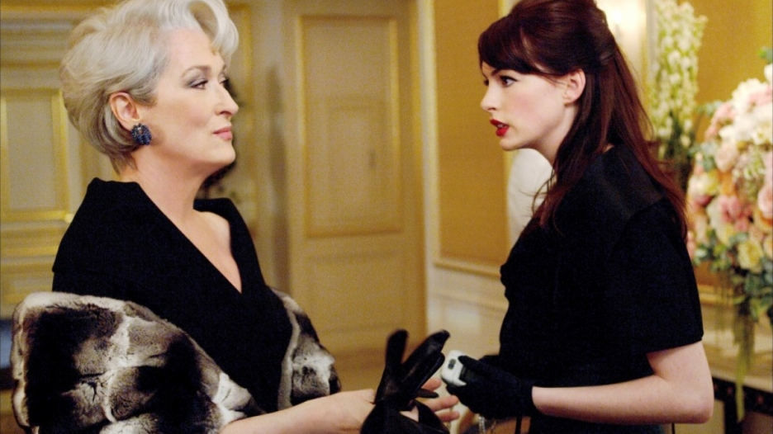

Slide 8
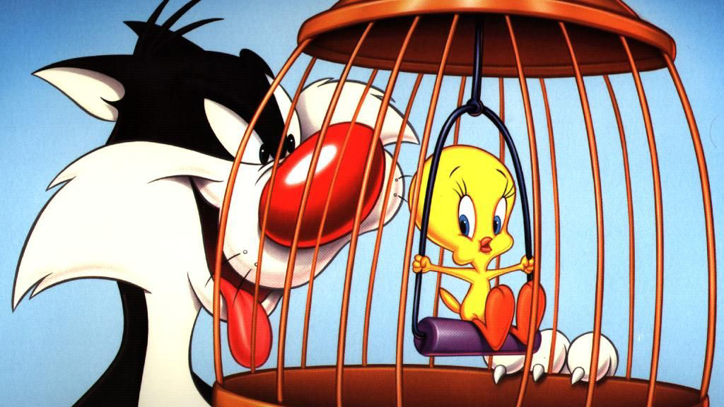

Slide 9
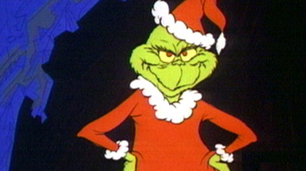

Slide 10
Crazy is not
Irritating

Slide 11
Crazy is not
Irritating
A non-favorite

Slide 12
Crazy is not
Irritating
A non-favorite
A bad day

Slide 13
VIDEO

Slide 14
Crazy Is
Mean-Spirited

Slide 15
Crazy Is
Mean-Spirited
Intentionally trying to make you feel small.

Slide 16
Proverbs 4:14-16
Do not do as the wicked do or follow the path of evildoers. Avoid their haunts. Turn away and go somewhere else, for evil people cannot sleep until they have done their evil deed for the day. They cannot rest unless they have caused someone to stumble.

Slide 17
What Causes Crazy?
Many reasons, but the most common is bitterness.

Slide 18
Hebrews 12:15
Be careful that no one misses the grace of God so that no root of bitterness grows among you and makes trouble, because it can poison a large number of people.

Slide 19
How Do You Handle
Crazy?
Evaluate your own behavior and ask, “what do I contribute to this environment?”

Slide 20
How Do You Handle
Crazy?
Evaluate your own behavior and ask, “what do I contribute to this environment?”
Accept your limitations

Slide 21
Romans 12:18
If it is possible, as far as it depends on you, live at peace with everyone.

Slide 22
I am not God
I cannot force someone to change their mind.

Slide 23
I am not God
I cannot force someone to change their mind.
I am not responsible for their choices, reactions and responses.

Slide 24
Refuse to play their game and walk through their poisonous doors.

Slide 25
Proverbs 1:10
My child, if sinners entice you, turn your back on them!

Slide 26
Proverbs 26:4
When arguing with fools, don't answer their foolish arguments, or you will become as foolish as they are.

Slide 27
Don’t be aggressive or passive, but choose the blessing of meekness.

Slide 28
Matthew 5:5
Blessed are the meek, for they will inherit the earth.

Slide 29
WWJD

Slide 30
WWJD
Sometimes he rebuked

Slide 31
WWJD
Sometimes he rebuked
Sometimes he avoided

Slide 32
WWJD
Sometimes he rebuked
Sometimes he avoided
Sometimes he endured

Slide 33
7. Live for an audience of One.

Slide 34
1 Thessalonians 2:4
We are not trying to please men but God, who tests our hearts.

